Slide 1
Chp:4 Javascript
Prepared by: Er. Simanta Kasaju

Slide 2
What’s a Scripting Language?
Language used to write programs that compute inputs to another language processor
One language embedded in another
Embedded JavaScript computes HTML input to the browser
Shell scripts compute commands executed by the shell
Common characteristics of scripting languages
String processing – since commands often strings
Simple program structure, define things “on the fly”
Flexibility preferred over efficiency, safety
Is lack of safety a good thing? (Example: JavaScript used for Web applications…)

Slide 3
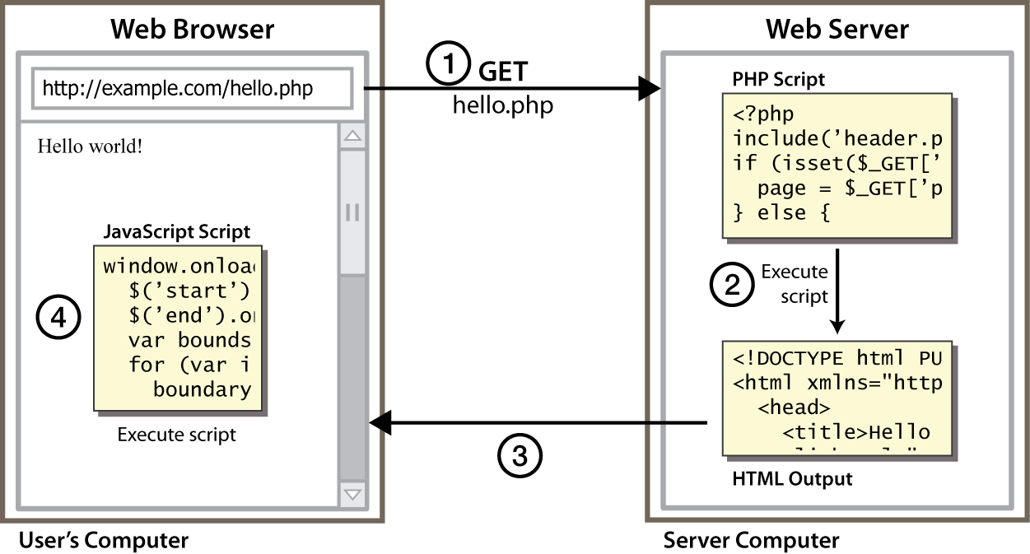
Client Side Scripting

Slide 4
Why use client-side programming?
PHP already allows us to create dynamic web pages. Why also use client-side scripting?
client-side scripting (JavaScript) benefits:
usability: can modify a page without having to post back to the server (faster UI)
efficiency: can make small, quick changes to the page without waiting for the server
event-driven: can respond to user actions like clicks and key presses.
server-side programming (PHP) benefits:
security: has access to server's private data; client can't see source code
compatibility: not subject to browser compatibility issues
power: can write files, open connections to servers, and connect to databases, ...

Slide 5
Introduction
It is a scripting language most often used for client-side web development.
It is an object-oriented scripting language that enables us to create interactive effects on web pages.
JavaScript is the programming language of the Web.
JavaScript is one of the 3 languages all web developers must learn:
1. HTML to define the content of web pages
2. CSS to specify the layout of web pages
3. JavaScript to program the behavior of web pages

Slide 6
Cont..
a lightweight programming language ("scripting language")
used to make web pages interactive
insert dynamic text into HTML (ex: user name)
react to events (ex: page load user click)
get information about a user's computer (ex: browser type)
perform calculations on user's computer (ex: form validation)
a web standard (but not supported identically by all browsers)
NOT related to Java other than by name and some syntactic similarities

Slide 7
Why JavaScript is called client-side scripting language?
JavaScript is called client-side scripting language because it runs in web browsers for interactions with users and web browsers usually run on the client.
For example JavaScript can be used to make HTML/XHTML documents respond to user inputs such as mouse clicks, keyboard use, etc.
Other examples of client-side scripting languages are: Microsoft VBScript, Java Applets, Adobe Flex, etc

Slide 8
Evolution
JavaScript, which was developed by Netscape, was originally named Mocha but soon was renamed LiveScript.
In late 1995 LiveScript became a joint venture of Netscape and Sun Microsystems, and its name again was changed, to JavaScript.
JavaScript was invented by Brendan Eich in 1995, and became an ECMA (European Computer Manufacturers Association) standard in 1997.ECMA-262 is the official name of the standard.
ECMAScript is the official name of the language.

Slide 9
Advantages of using client-side scripting language:
Allow for more interactivity by immediately responding to users' actions
Execute quickly because they don't require a trip to the server
Quick validation of forms inputs
May improve the usability of Web sites for users
Can give developers more control over the look and behavior of their Web widgets
Are easy to manipulate codes as well as the user interface
Can be used to change HTML elements/ attributes, CSS styles, and so on.

Slide 10
Can JavaScript be used for server-side scripting?
Yes, since the advent of Node.js and its frameworks we can use JavaScript on both the Client side and server side. Node.js is a JavaScript runtime built that uses an event-driven, non-blocking I/O model that makes it lightweight and efficient.
MEAN (MongoDB, ExpressJS, AngularJS, and Node.js) stack, used to develop web applications is also the collection of JavaScript-based technologies.

Slide 11
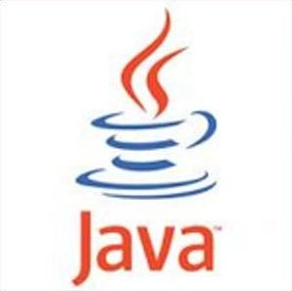
Javascript vs Java
interpreted, not compiled
more relaxed syntax and rules
fewer and "looser" data types
variables don't need to be declared
errors often silent (few exceptions)
key construct is the function rather than the class
"first-class" functions are used in many situations
contained within a web page and integrates with its HTML/CSS content

Slide 12

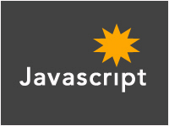
+
=

Slide 13
Although there is a similarity between Java and JavaScript in the syntax of their expressions, assignment statements, and control statements but there are key differences which are as follows:
Java is an OOP programming language (mostly compiled) while Java Script is an OOP scripting language (mostly interpreted).
Java creates applications that run in a virtual machine or browser while JavaScript code is run on a browser only.
Java code needs to be compiled while JavaScript code need not be compiled and are all in text.
Java is a strongly typed language. Types are all known at compile time, and operand types are checked for compatibility. Variables in JavaScript need not be declared and are dynamically typed, making compile-time type checking impossible.
Objects in Java are static in the sense that their collection of data members and methods is fixed at compile time. JavaScript objects are dynamic: the number of data members and methods of an object can change during execution.
They require different plug-ins.

Slide 14
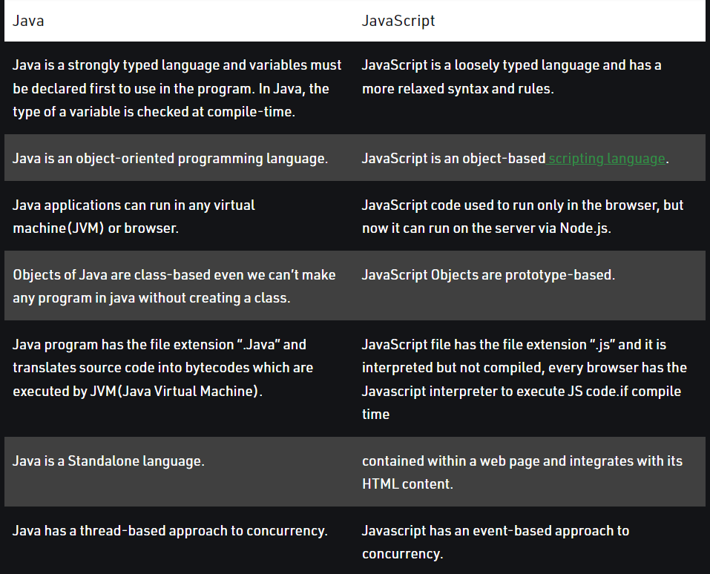

Slide 15
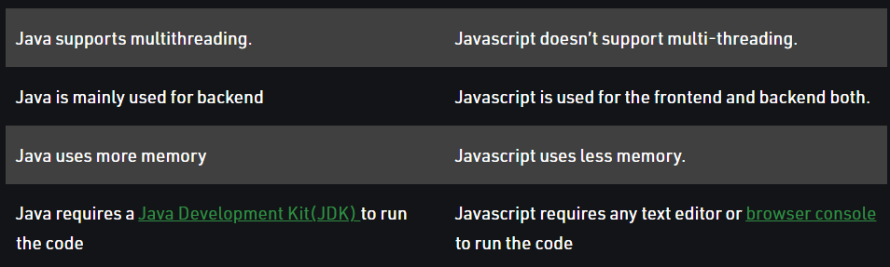

Slide 16
JavaScript vs. PHP
similarities:
both are interpreted, not compiled
both are relaxed about syntax, rules, and types
both are case-sensitive
both have built-in regular expressions for powerful text processing

Slide 17
cont..
differences:
JS is more object-oriented: noun.verb(), less procedural: verb(noun)
JS focuses on user interfaces and interacting with a document; PHP is geared toward HTML output and file/form processing
JS code runs on the client's browser; PHP code runs on the web server

Slide 18
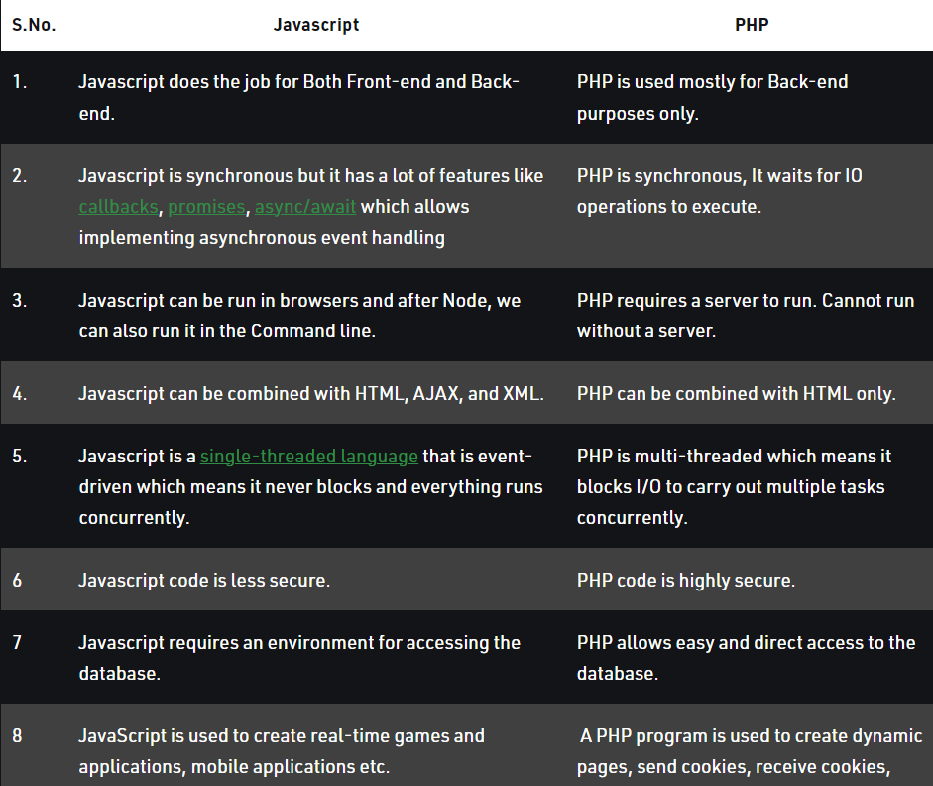

Slide 19
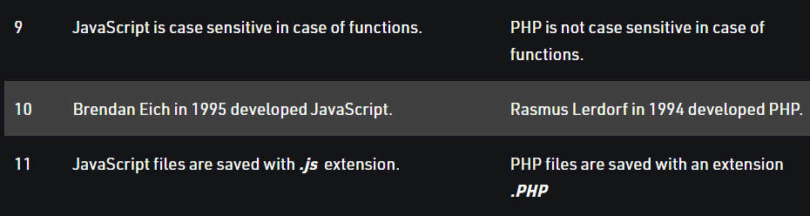

Slide 20
Parts of JavaScript:
JavaScript can be divided into 3 parts:
i. The Core JavaScript: The core JavaScript includes its operators, expressions, statements and subprograms.
ii. Client-side JavaScript: It is the collection of objects that supports the control of browser and interactions with users. For example, XHTML/HTML document made responsive to user inputs such as mouse clicks, keyboard use, etc. with the help of JavaScript.
iii. Server-side JavaScript: It is a collection of objects that make the language useful on a Web server—for example, to support communication with a database management system.

Slide 21
Examples of Uses of JavaScript as client-side scripting language:
Interactions with users through form elements, such as buttons and menus, can be conveniently described in JavaScript. Because button clicks and mouse movements are easily detected with JavaScript, they can be used to trigger computations and provide feedback to the user.
Interactions with user without forms, which take place in dialog windows, include getting input from the user and allowing the user to make choices through buttons. It is also easy to generate new content in the browser display dynamically.
JavaScript Document Object Model (DOM), allows JavaScript scripts to access and modify the CSS properties and content of the elements of a displayed XHTML document, making formally static documents highly dynamic.

Slide 22
Advantages of JS
Cross Browser supporting: JavaScript codes are supported by various browsers like Internet Explorer, Netscape Navigator, Mozilla etc.
Platform independent: JS codes can be executed in any platform like Linux, Microsoft Windows, and many other OS.
Lightweight for fast downloading: JS codes run directly in the client machine. The code should be downloaded all the way from the server to the client and this time duration is very minimum and the execution of the codes of JS is also very fast.
Validating Data: The data can be validated in 2 different ways:
-Validating in the server side or in the server machine
- Validating in client side or in client machine

Slide 23
cont..
Sophisticated UI: By using JS you can create a UI that can communicate with the user and the Browser.
In Built software: You don’t need extra tools to write JS any plain text or HTML editor will do so there is no expensive development software to buy.
Easy to learn: The JS programmer should know the minimal syntax of JS since it supports many syntax and data types as C and C++.
Designed for programming User Events: JS supports object/Event-based Programming. So the code written in JavaScript can easily be broken down into sub-modules.

Slide 24
Disadvantages
Launching an application on the client’s computer: JS is not used to create stand-alone applications, it is only used to add some functionality in any web page.
Reading or writing files: JavaScript cant read and write files into the client machines. It can only be used as a utility language to develop any web site.Retrieving the text contents of HTML pages or files from the server.
Reading and writing files to the server: JavaScript can read and write to any file in the server as well.
Sending secret e-mails from website visitors to you: JS cant be used to send emails to the visitors or users of the website. This can be done only with server-side scripting.
Cannot create database application: By using you cant connect the website to the database.For this you need to use server side scripting

Slide 25
Cont..
Browser Compatibility issues: Not all browsers support the JS codes. The browser may support JS as a whole but may not support the codes or line of codes written in JS and may interpret differently.
JS does not implement multiprocessing or multithreading.
JS has limitations of writing in a client machine. It can only write the cookie in their machine that is also of a certain size i.e 4K

Slide 26
Application Of JS
Used to create interactive(dynamic) websites.
Client-side validation.
Displaying date and time.
Dynamic drop-down menus
Navigation systems
Basic math calculations
Displaying pop-up windows and dialog boxes(like an alert dialog box, confirm dialog box).
Displaying clocks.
JS can update and change both HTML and CSS.
JS can calculate, manipulate and validate data.
Provide events based on user action to design CSS and HTML.

Slide 27
Ways to embed JavaScript in XHTML/HTML document:
i. Explicit embedding:
JavaScript code physically residing in concerned XHTML document- may be on head or body depending on the purpose of script within desired mime type of <script> tag.
e.g <script type “text/javascript”>
……js code…..
</script>)
ii. Implicit embedding:
JavaScript code residing in separate .js file and that file included in the desired XHTML document- may be on head or body.
e.g. XHTML document:
<html>
<head>
<script type=”text/javascript” src=”jquery.js”></script>
</head>
<body>
………XHTML code…..
</body>
</html>

Slide 28
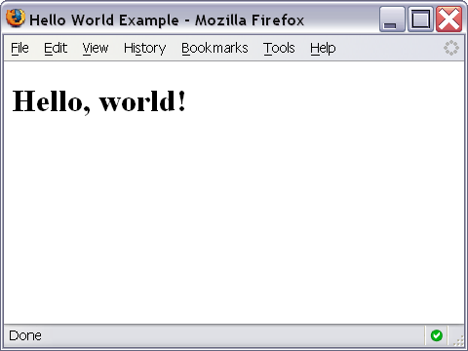
1st JS example
<script>
document.write("simanta");
</script>
<!DOCTYPE html>
<html>
<head>
<title>Hello World Example</title>
</head>
<body>
<script type="text/javascript">
<!--
document.write("<h1>Hello, world!</h1>");
//-->
</script>
</body>
</html>

Slide 29
document.write()
Ends in a semicolon
document.write("<h1>Hello,world!</h1>");
Enclosed in quotes -- denotes a "string"

Slide 30
Types of JavaScript Comments
There are two types of comments are in JavaScript
Single-line Comment
Multi-line Comment
Single-line Comment
<script>
// It is single line comment document.write("Hello Javascript");
</script>

Slide 31
Multi-line Comment
<script>
/* It is multi line comment. It will not be displayed */
document.write("Javascript multiline comment");
</script>

Slide 32
JavaScript Code:
JavaScript code (or just JavaScript) is a sequence of JavaScript statements. Each statemen is executed by the browser in the sequence they are written. Following example will write a heading and two paragraphs to a web page: Example
<script type="text/javascript">
document.write("<h1>This is a heading</h1>");
document.write("<p>This is a paragraph.</p>");
document.write("<p>This is another paragraph.</p>");
</script>

Slide 33
JavaScript Code Blocks:
JavaScript statements can be grouped together in code blocks, inside curly brackets {...}. The purpose of code
blocks is to define statements to be executed together. One place you will find statements grouped together in
blocks, are in JavaScript functions:
Example
function myFunction() {
document.write("hello");
document.write("Dev");
}

Slide 34
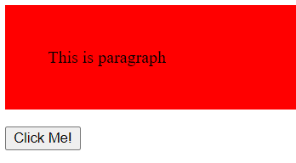
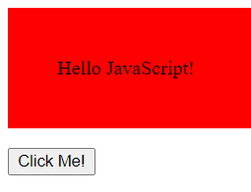
<body>
<div>
<p id="A">This is paragraph</p>
</div>
<button type="button" onclick=AB();>Click Me!</button>
<script src="a.js">
</script>
function AB(){
document.getElementById("A").innerHTML = "Hello JavaScript!";
}
OR
<button type="button" onclick='document.getElementById("A").innerHTML="Hello Javascript"'>
Click here</button>

Slide 35
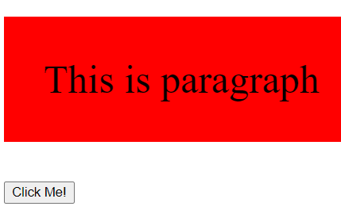
<body>
<div>
<p id="A">This is paragraph</p>
</div>
<button type="button" onclick=AB();>Click Me!</button>
<script src="a.js">
</script>
function AB(){
document.getElementById("A").style.fontSize = "40px";
}
OR
<button type="button" onclick='document.getElementById("A").style.fontSize="35px"'>
Click here</button>

Slide 36
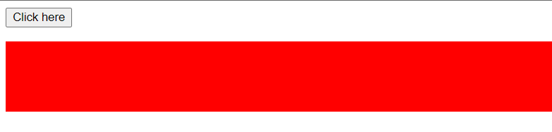
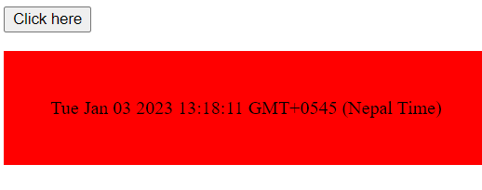
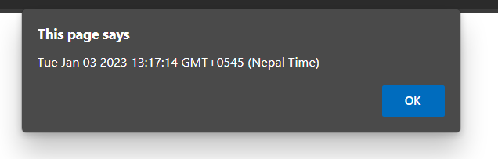
function AB(){
document.getElementById("A").innerHTML = Date();
}
<body>
<button type="button" onclick=AB();>
Click here</button>
<p id="A"></p>
<script src="a.js">
</script>
</body>
var my_time=new Date();
alert (my_time);

Slide 37
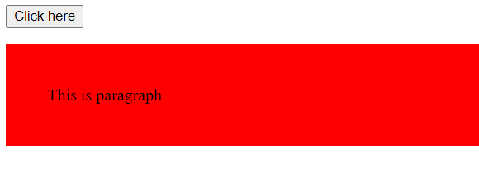

p#A{
background-color: red;
padding: 40px;
}
</style>
</head>
<body>
<button type="button" onclick=AB();>
Click here</button>
<p id="A">This is paragraph</p>
<script src="a.js">
</script>
function AB(){
document.getElementById("A").style.display ="none";
}

Slide 38
<style>
p#A{
background-color: red;
padding: 40px;
display: none;
}
</style>
</head>
<body>
<button type="button" onclick=AB();>
Click here</button>
<p id="A" >This is paragraph</p>
<script src="a.js">
</script>
</body>
function AB(){
document.getElementById("A").style.display ="block";
}

Slide 39
JavaScript Display Possibilities
JavaScript can "display" data in different ways:
Writing into an HTML element, using innerHTML.
Writing into the HTML output using document.write().
Writing into an alert box, using window.alert().
Writing into the browser console, using console.log().

Slide 40
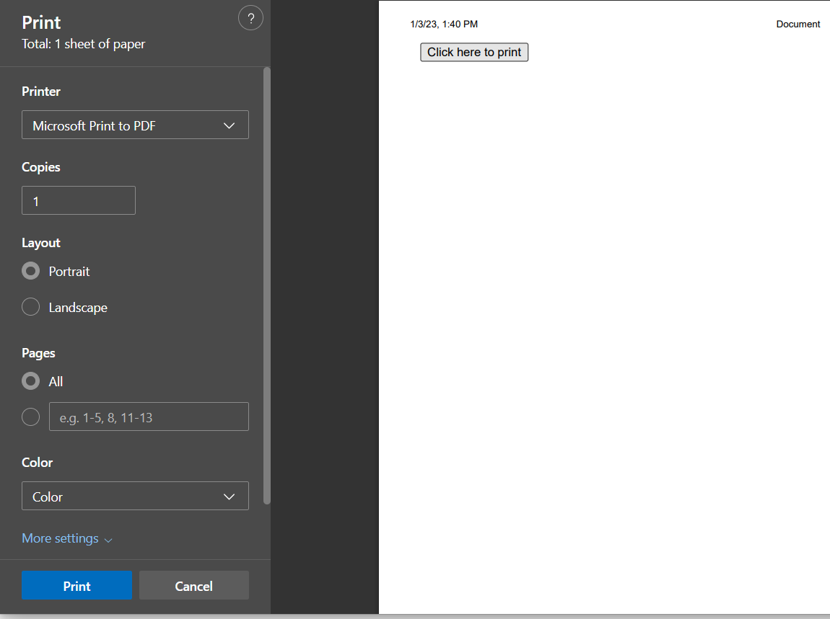
<button onclick='window.print();'>Click here to print</button>

Slide 41
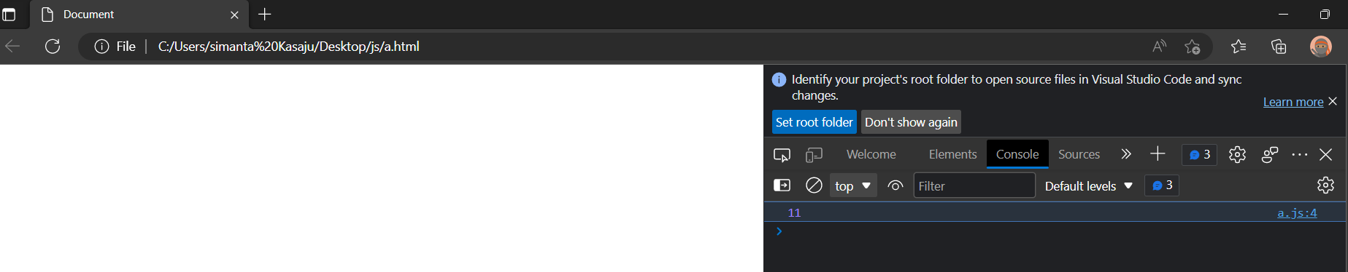
var a=5;
var b=6;
var c=a+b;
console.log(c);
<script src="a.js">
</script>

Slide 42
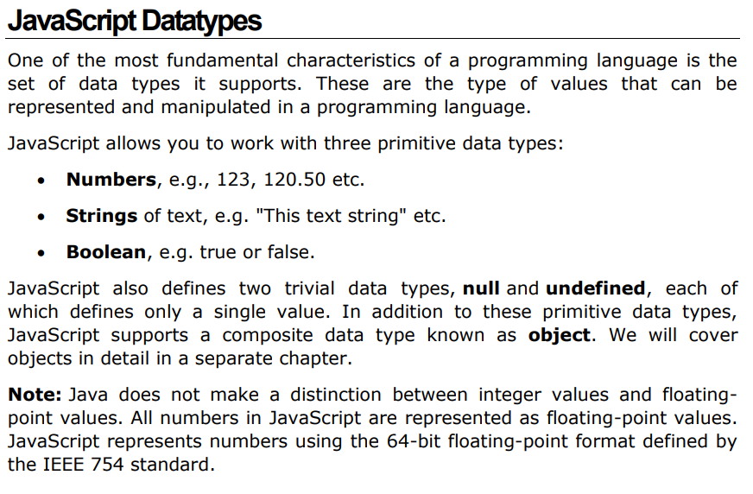
Variables

Slide 43
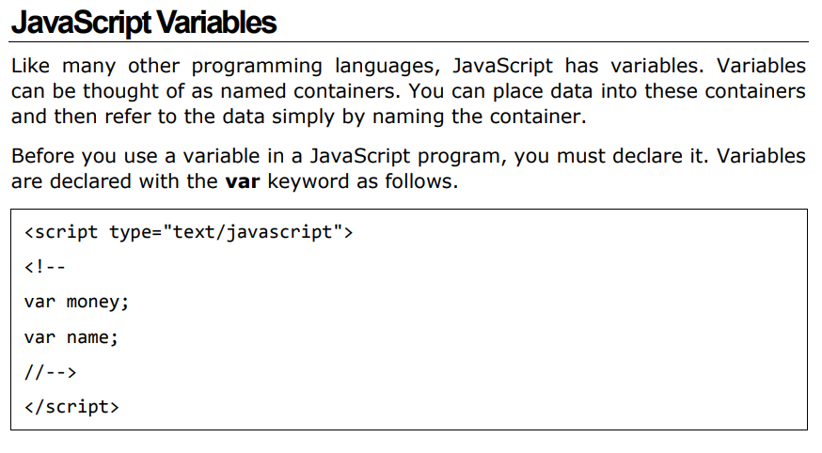

Slide 44
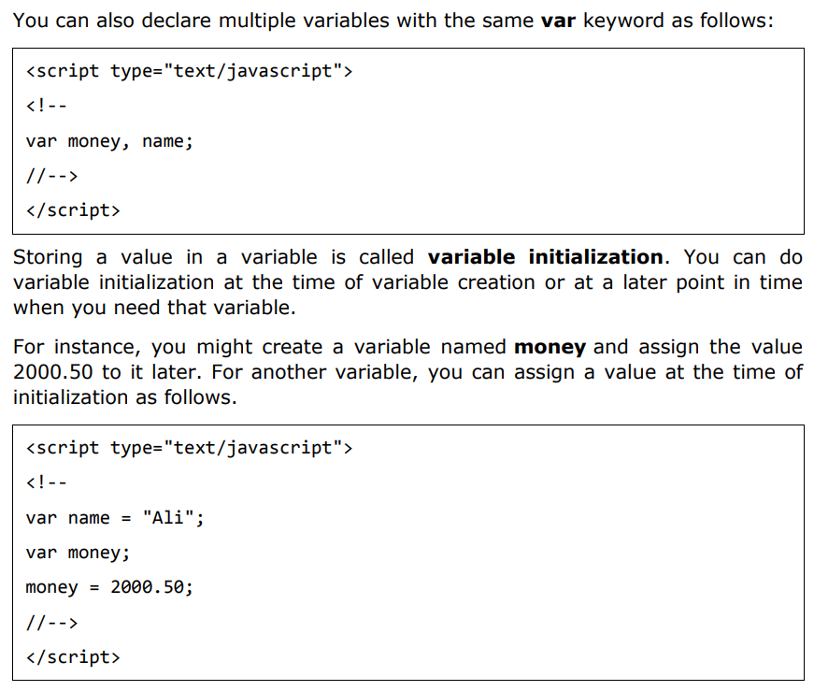
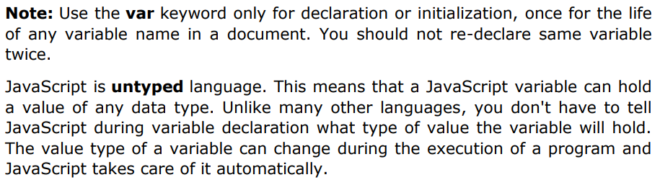

Slide 45
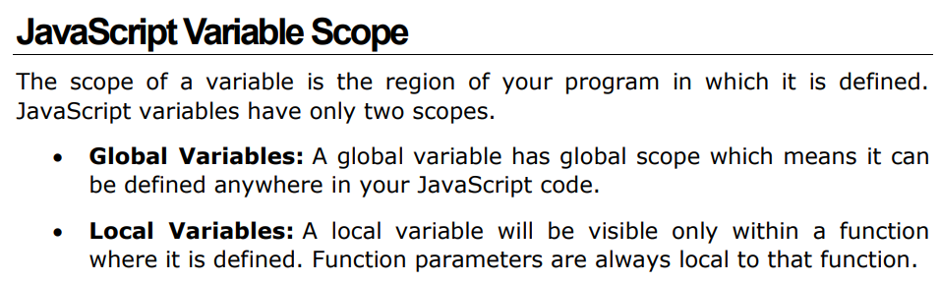
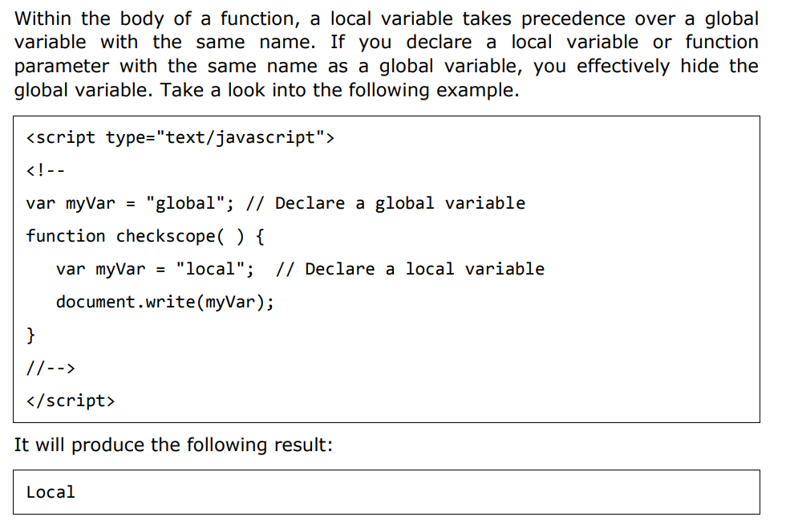

Slide 46
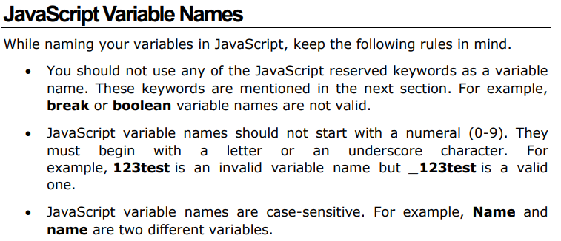

Slide 47
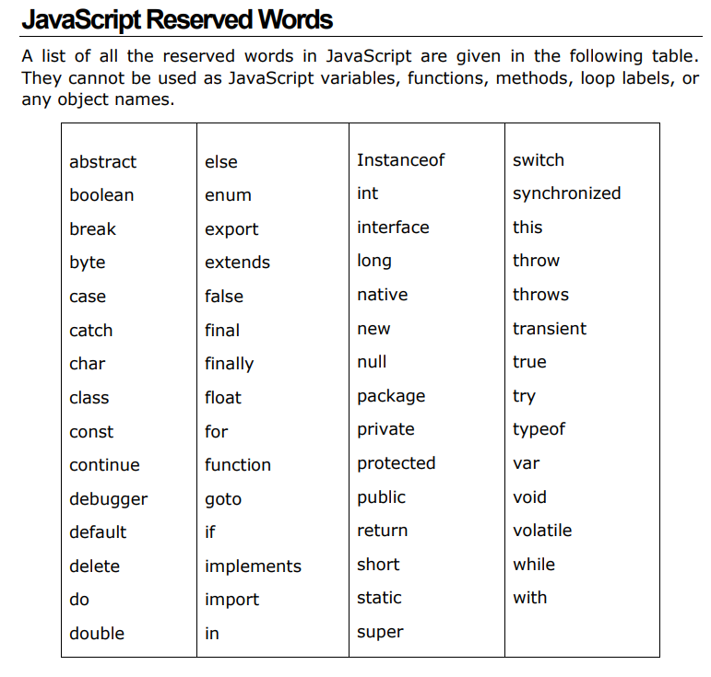

Slide 48
JavaScript Variables
4 Ways to Declare a JavaScript Variable:
Using var
Using let
Using const
Using nothing
What are Variables?
Variables are containers for storing data (storing data values).
In this example, x, y, and z, are variables, declared with the var keyword:
<script>
var x = 5;
var y = 6;
var z = x + y;
document.getElementById("demo").innerHTML =
"The value of z is: " + z;
</script>
<script>
let x = 5;
let y = 6;
let z = x + y;
document.getElementById("demo").innerHTML =
"The value of z is: " + z;
</script>

Slide 49
Let
Variables defined with let cannot be Redeclared.
Variables defined with let must be Declared before use.
Variables defined with let have Block Scope.
const
Variables defined with const cannot be Redeclared.
Variables defined with const cannot be Reassigned.
Variables defined with const have Block Scope.
const PI = 3.14159265359;

Slide 50
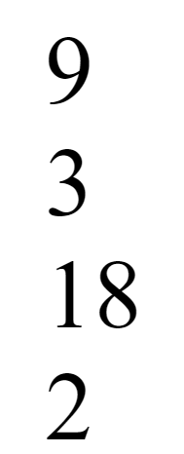
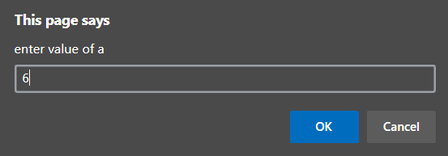
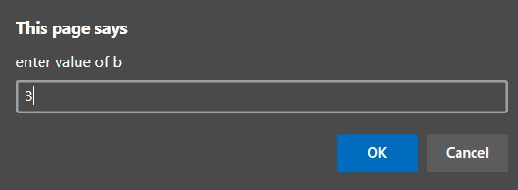
var a=Number(prompt("enter value of a"));
var b=Number(prompt("enter value of b"));
document.write(a + b);
document.write(a - b);
document.write(a * b);
document.write(a / b);

Slide 51
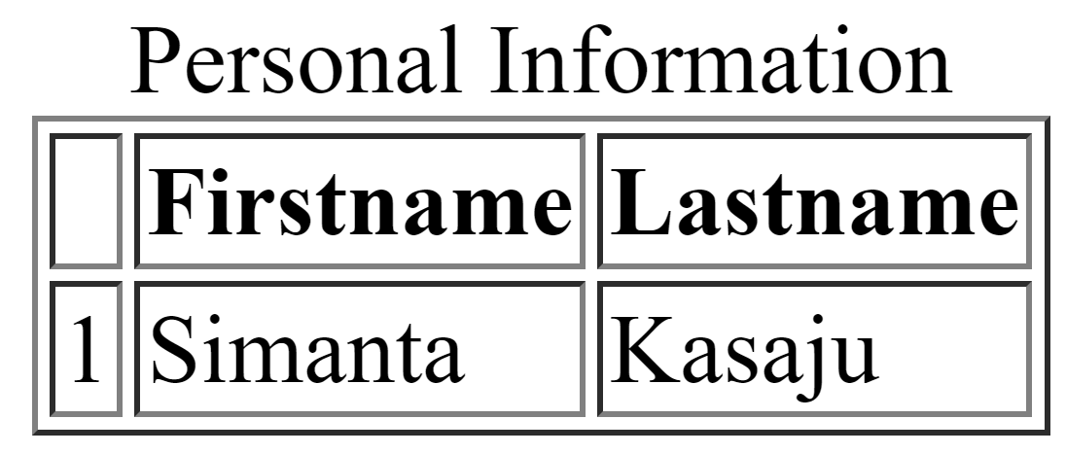
var bordersize;
bordersize =prompt("select a border table size\n"+"1");
switch (bordersize)
{
case "0": document.write("<table>");
break;
case "1": document.write("<table border='1'>");
break;
case "4": document.write("<table> border='4'>");
break;
case "8": document.write("<table border='8'>>");
break;
default:document.write("error");
}
document.write("<caption>Personal Information </caption>");
document.write("<tr>","<th></th>","<th> Firstname </th>"
,
"<th>Lastname</th>",
"</tr>",
"<tr>",
"<td>1</td>",
"<td>Simanta</td>",
"<td>Kasaju</td>",
"</tr>");

Slide 52
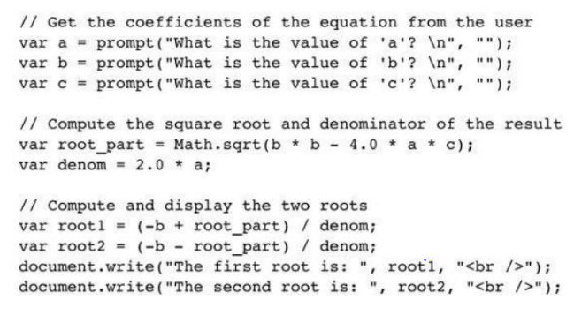

Slide 53
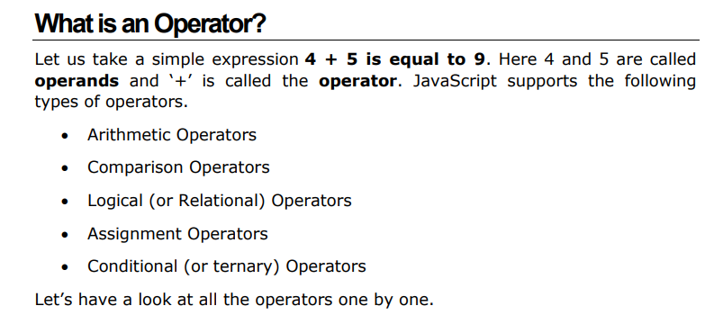

Slide 54
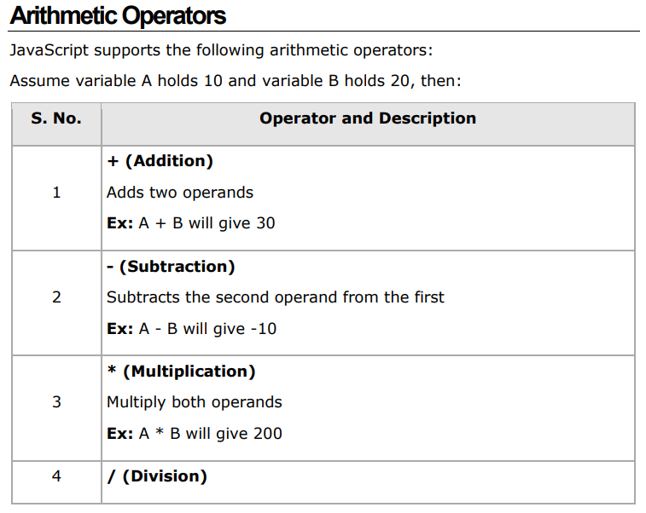
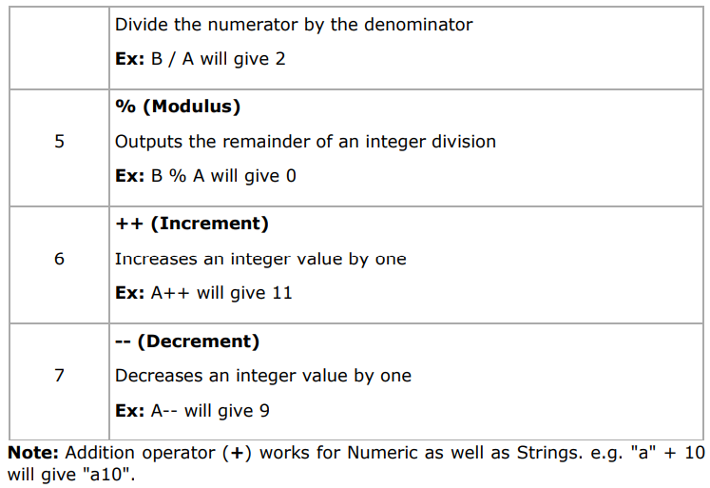

Slide 55
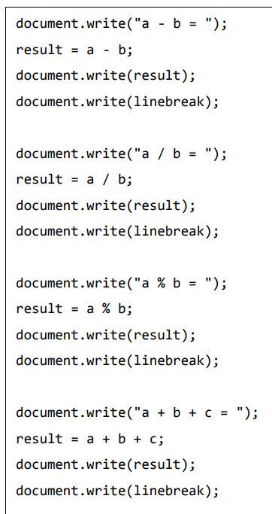
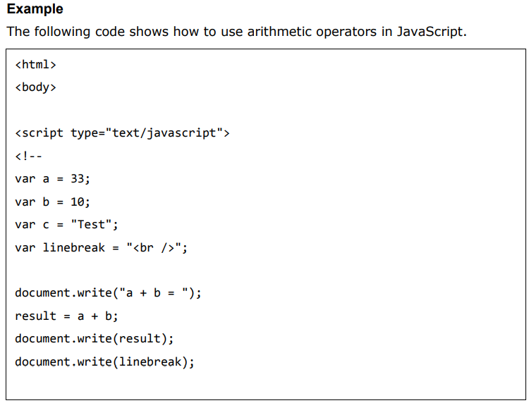
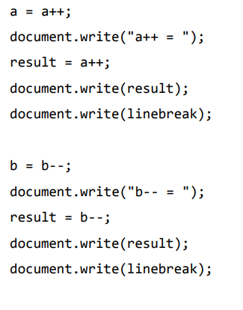

Slide 56
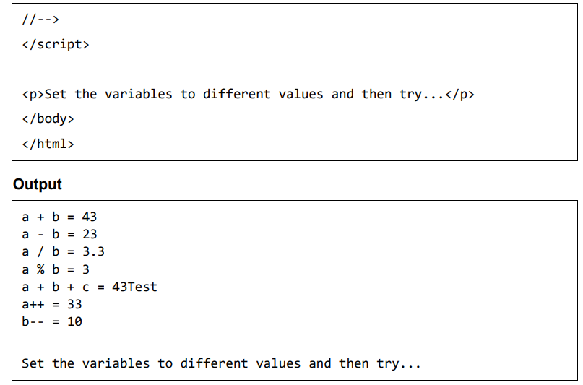

Slide 57
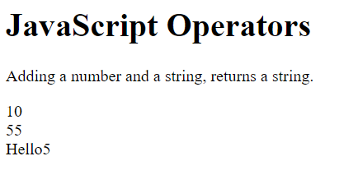
<script>
let x = 5 + 5;
let y = "5" + 5;
let z = "Hello" + 5;
document.getElementById("demo").innerHTML =
x + "<br>" + y + "<br>" + z;
</script>

Slide 58
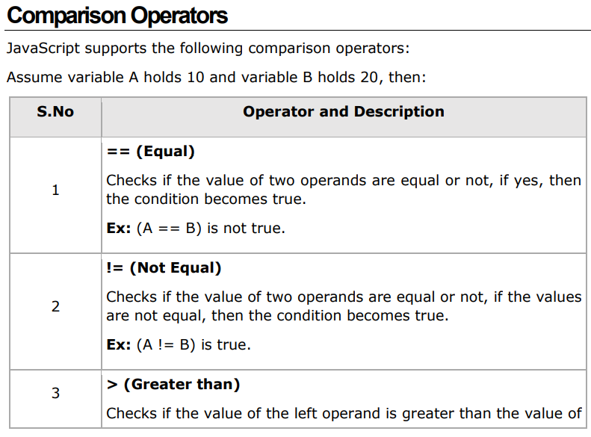
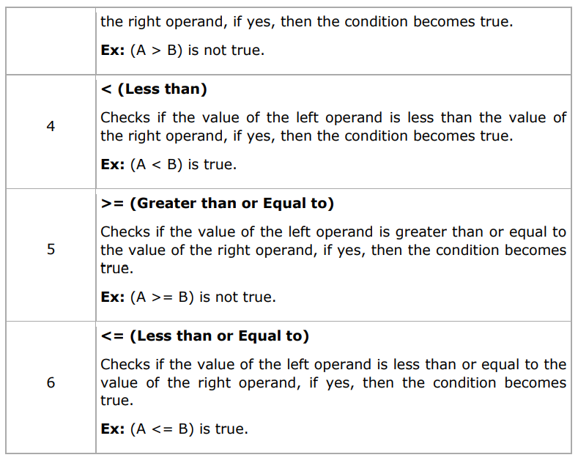
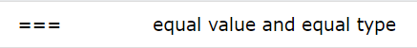
(Identical)
(non Identical)

Slide 59
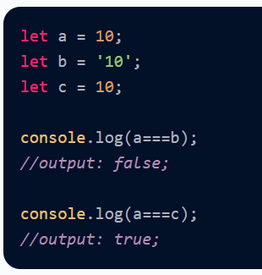
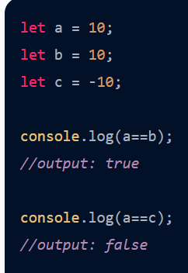
== is Abstract equality just values are compared
=== is strict equality values and datatypes are compared.

Slide 60
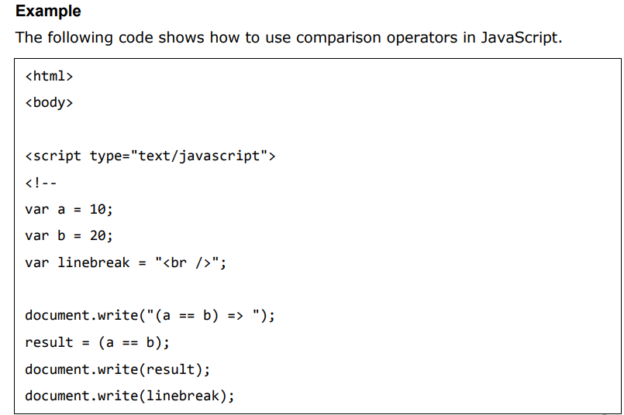
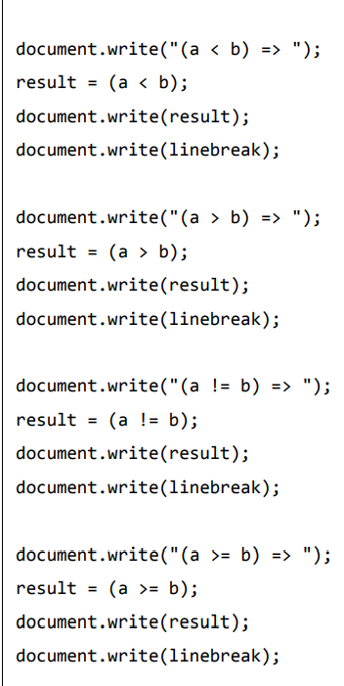

Slide 61
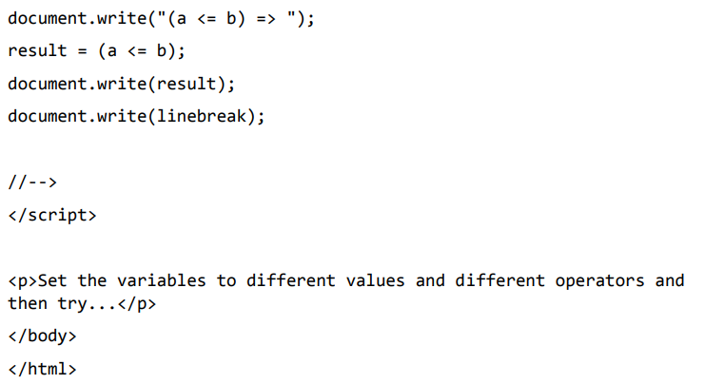

Slide 62
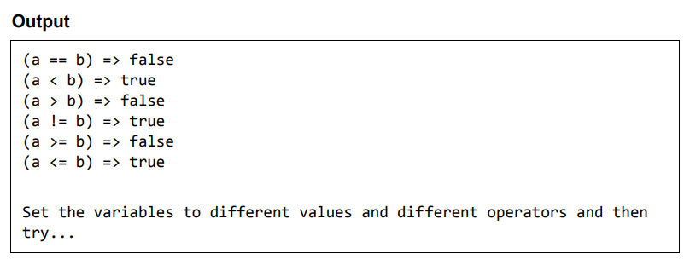

Slide 63
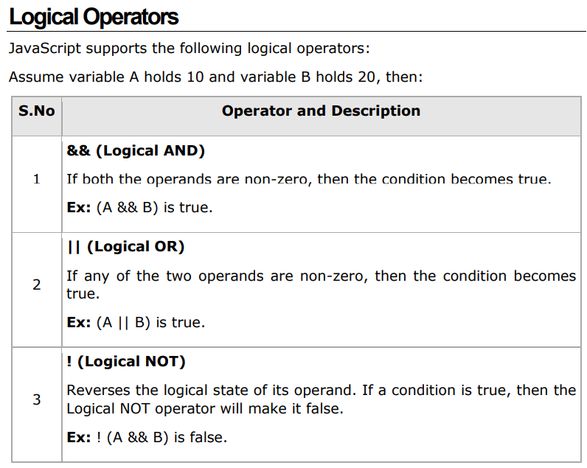

Slide 64
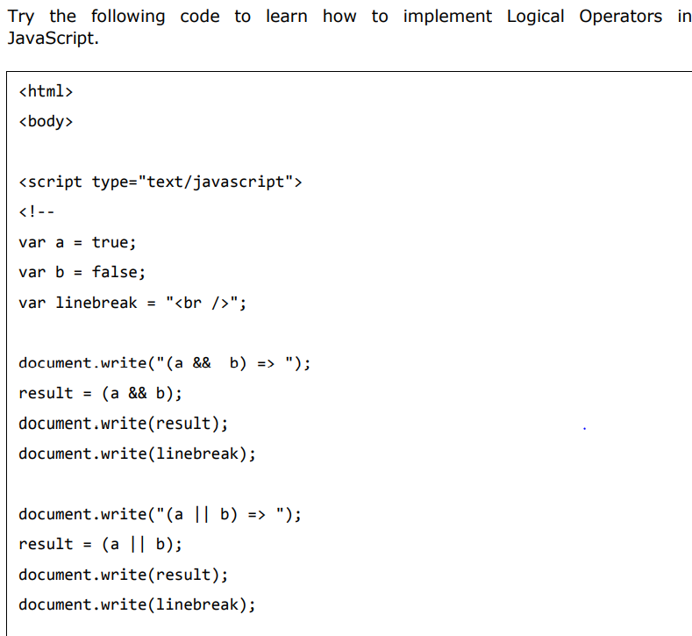
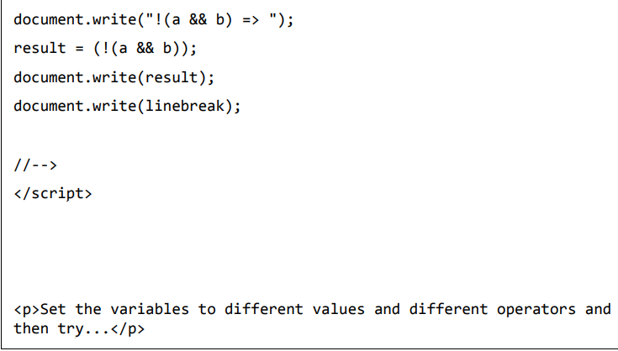

Slide 65


Slide 66



Slide 67



Slide 68


Slide 69



Slide 70



Slide 71




Slide 72




Slide 73




var a=10;
alert(typeof a);
let a="simanta kasaju";
alert(typeof a);

Slide 74

Conditional Statement
While writing a program, there may be a situation when you need to adopt one out of a given set of paths. In such cases, you need to use conditional statements that allow your program to make correct decisions and perform the right actions. JavaScript supports conditional statements which are used to perform different actions based on different conditions. Here we will explain the if..else statement.

Slide 75




Slide 76


Slide 77



Slide 78




Slide 79

Switch case
You can use multiple if...else…if statements, as in the previous chapter, to perform a multiway branch. However, this is not always the best solution, especially when all branches depend on a single variable's value. Starting with JavaScript 1.2, you can use a switch statement that handles exactly this situation, and it does so more efficiently than repeated if...else if statements.

Slide 80





Slide 81




Slide 82

Loop
While writing a program, you may encounter a situation where you must perform an action repeatedly. In such situations, you would need to write loop statements to reduce the number of lines. JavaScript supports all the necessary loops to ease down the pressure of programming.
The while Loop The most basic loop in JavaScript is the while loop which would be discussed in this chapter. The purpose of a while loop is to execute a statement or code block repeatedly as long as an expression is true. Once the expression becomes false, the loop terminates. Flow Chart The flow chart of the while loop looks as follows:

Slide 83





Slide 84




Slide 85



Slide 86


Slide 87



Slide 88




Slide 89



JavaScript provides full control to handle loops and switch statements. There may be a situation when you need to come out of a loop without reaching at its bottom. There may also be a situation when you want to skip a part of your code block and start the next iteration of the look. To handle all such situations, JavaScript provides break and continue statements. These statements are used to immediately come out of any loop or to start the next iteration of any loop respectively.

Slide 90





Slide 91
Question
1. Write JS to display the sum of n natural number
2. Even and odd
3. Prime number
4. Multiplication table
5. Reverse

Slide 92
var a=Number(prompt("enter a number"));
if((a%2)==0)
{
document.write("even");
}
else{
document.write("odd");
}

Slide 93
var today=new Date();
var date=today.toLocaleString();
var day=today.getDay();
var month=today.getMonth();
var year= today.getFullYear();
var time=today.getTime();
var hour=today.getHours();
var min=today.getMinutes();
var sec=today.getSeconds();
var mili=today.getMilliseconds();
document.write(today);
document.write("<br>");
document.write(date);
document.write("<br>");
document.write(day);
document.write("<br>");
document.write(month);
document.write("<br>");
document.write(year);
document.write("<br>");
document.write(time);
document.write("<br>");
document.write(hour);
document.write("<br>");
document.write(min);
document.write("<br>");
document.write(sec);
document.write("<br>");
document.write(mili);

